Slide 1
Lecture 1: Review of 109A Preview of 109B

Slide 2
Outline
Who
What have we learned in 109a?
What is covered in 109b
Course Logistics

Slide 3
Outline
Who
What have we learned in 109a?
What is covered in 109b
Course Logistics

Slide 4
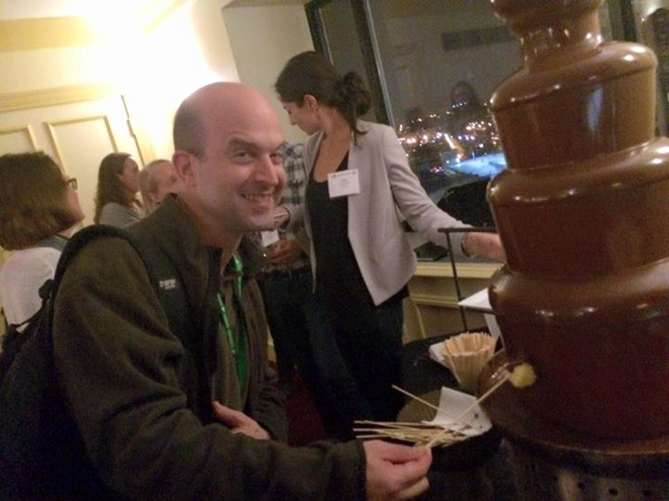
Who: Instructors
Mark Glickman: Senior Lecturer in Statistics

Slide 5
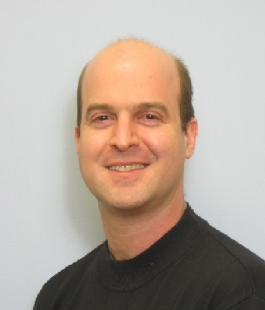
Who: Instructors (cont)
About Mark Glickman:
BA in Statistics from Princeton; PhD in Statistics from Harvard
Chess master, inventor of Glicko and Glicko-2 rating systems for head-to-head competition, ratings committee chair of US Chess
Former Editor-in-Chief of the Journal of Quantitative Analysis in Sports (2015-2017)
Director of the Harvard Sports Analytics Laboratory
Senior Statistician at the Center for Healthcare Organization and Implementation Research, a Veterans Administration Center of Innovation
Fellow of the American Statistical Association
Board of Directors member of the American Statistical Association (ASA); Co-Chair of the Committee on Data Science of the ASA.

Slide 6
Who: Instructors (cont)
Pavlos Protopapas: Scientific Director of the Institute for Applied Computational Science (IACS)

Slide 7
About Pavlos Protopapas
BSc in Physics, Imperial College, PhD in Theoretical Physics, UPENN
Teaches CS109 and the IACS Capstone Course
Active member of the astrostatistics community. Research at the intersection of astronomy, machine learning and statistics
Member of Alerce, an intelligent broker for online annotating celestial objects from streaming data
Loves classical music, hiking and anything adventurous

Slide 8
Who: Lab Instructors
Rahul Dave
Lecturer at IACS. PhD in cosmology and teaches AM207. He loves climbing, hiking and he is also known as the human Google.
Lab: AWS and scaling up your calculations (Lab 4)
Eleni Kaxiras
Eleni has been the CS109a/b Head TF for 3 years. She is also a staff member at SEAS, advising courses in the use of computation for teaching and learning. She holds a Bachelor’s in Physics and she produces her own olive oil.
Labs: NN optimization (Lab 3) and CNNs (Lab5)
Head TF

Slide 9
Who: Lab Instructors
Will Claybaugh
IACS Master's student, former social network analyst at Booz Allen Hamilton. Former fencer, built and flew on a cluster of 18 weather balloons,
Labs: Setting up environments (Lab 1), Smoothing/GAM (Lab2), Clustering Lab 7), Bayes 2 (Lab 9)
Srivatsan Srinivasan
IACS Masters Student, Former summer data science intern at Facebook. Incoming Research Engineer at DeepMind. Enjoy occasional creative writing and theater.
Labs: RNNs (Lab 6) and GANS (Lab 11)
Advanced Sections: Deep RL (a-sec 6), Variational Inference (a-sec 7)

Slide 10
Who: Lab Instructors
Vivek Hv
Vivek is a graduate student in the Design Engineering program. He has a background in product development, healthcare, and computer science. After his undergraduate studies in Aerospace Engineering, he joined Honeywell, where he worked on rapid prototyping and development of products for private jets. Beyond this, Vivek enjoys art, cats, soccer, waffles, programming, and trekking.
Labs: Bayes (Lab 8), Autoencoders and variational autoencoders (Lab 10).
Advanced Sections: GANS (A-sec 8)

Slide 11
Who: Advanced Section Leaders
Javier Zazo
Postdoc at SEAS. Works in optimal transport and neural signal processing. Comes from Madrid. Loves going to the mountains and good weather, and being outdoors. Many hobbies, from playing Go, watching movies, and hanging out. Hates cooking. Survives on minimal effort cooked foodstuff. But still loves delicious food.
Advanced Sections: Optimization (a-sec 1), Dropout (a-sec 2), Advanced CNNs (a-sec 3), NN transfer learning (a-sec 5)
Marios Matthaiakis
He is a postdoctoral fellow at IACS, computational physicist and trying to apply physical laws in Neural Network architectures. I came from Crete, a beautiful island in Greece.
Advanced Section: LSTN, GRU in NLP + (a-sec 4)

Slide 12
Who: Teaching Fellows
Sol Girouard
Reaching Fellow for 109a/b, while a Top of Class and Award Wining Student graduating as part of Harvard Class of 2018. She is a Quant, Mathematical Economist and Data Scientist who channels her applied interdisciplinary background in the intersection of financial markets and technology. Sol is training for her 2nd degree black belt in full contact Tae KwonDo.
Brandon Walker
Principal data scientist for LexisNexis Risk Solutions Healthcare Analytics Group. He has TF’ed CS109a twice.
Yujiao Chen
Ph.D student at GSD. She loves TF’ing 109.

Slide 13
Who: Teaching Fellows
Rashmi Banthia
She has been TF for long time for CS109A/B. Interests - Indian food and latest - Orangetheory (doesn’t mean I’m good at it)
Evan Mackay
Harvard College
Evan is from Florida and enjoys biking, podcasts, and sweet potatoes
Alex Lin
Harvard College
Alex enjoys working with Python(s)

Slide 14
Who: Teaching Fellows
Curtis Hsu
Curtis Hsu is a Senior at Harvard College living in Mather House studying statistics and computer science. He enjoys hip hop dancing in his free time!
Anirudh (Ani) Suresh
Ani (’20) is a Harvard undergraduate concentrating in Math & CS.

Slide 15
Outline
Who
What have we learned in 109a?
What is covered in 109b
Course Logistics

Slide 16
109A
Scraping, skLearn, numpy, Pandas, matplotlib
Visualization best practices
Linear, multiple and polynomial regression
Model Selection and regularization
Logistic Regression, multiple and polynomial.
kNN classification
Decision Trees, RF, Boosting, Stacking
SVM
AB testing and experimental design

Slide 17
Outline
Who
What have we learned in 109a?
What is covered in 109b
Course Logistics

Slide 18
Topics
The semester is divided into 2 parts.
Part 1: Smoothing, Unsupervised Learning and Bayesian inference all in python, Neural Networks in python and Keras.
Modules: Incorporates everything from 109a and 109b into modules.

Slide 19
Course topics covered by Glickman
Regression splines, smoothers, additive and generalized additive models
Unsupervised learning and cluster analysis
Introduction to Bayesian methods
Hierarchical modeling
Latent Dirichlet Allocation (topic modeling)

Slide 20
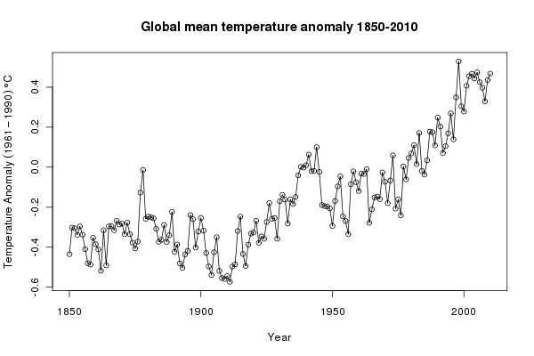
Course topics covered by Glickman (cont)
Smoothers and GAMs: (raw data)

Slide 21
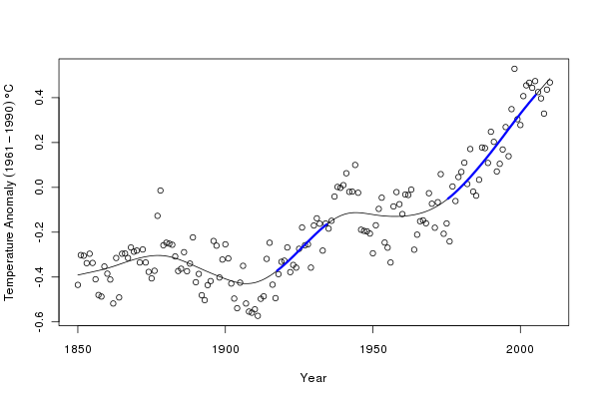
Course topics covered by Glickman (cont)
Smoothers and GAMs: (smoothed fit)

Slide 22
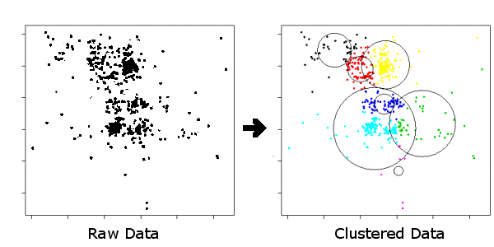
Course topics covered by Glickman (cont)
Cluster analysis:

Slide 23
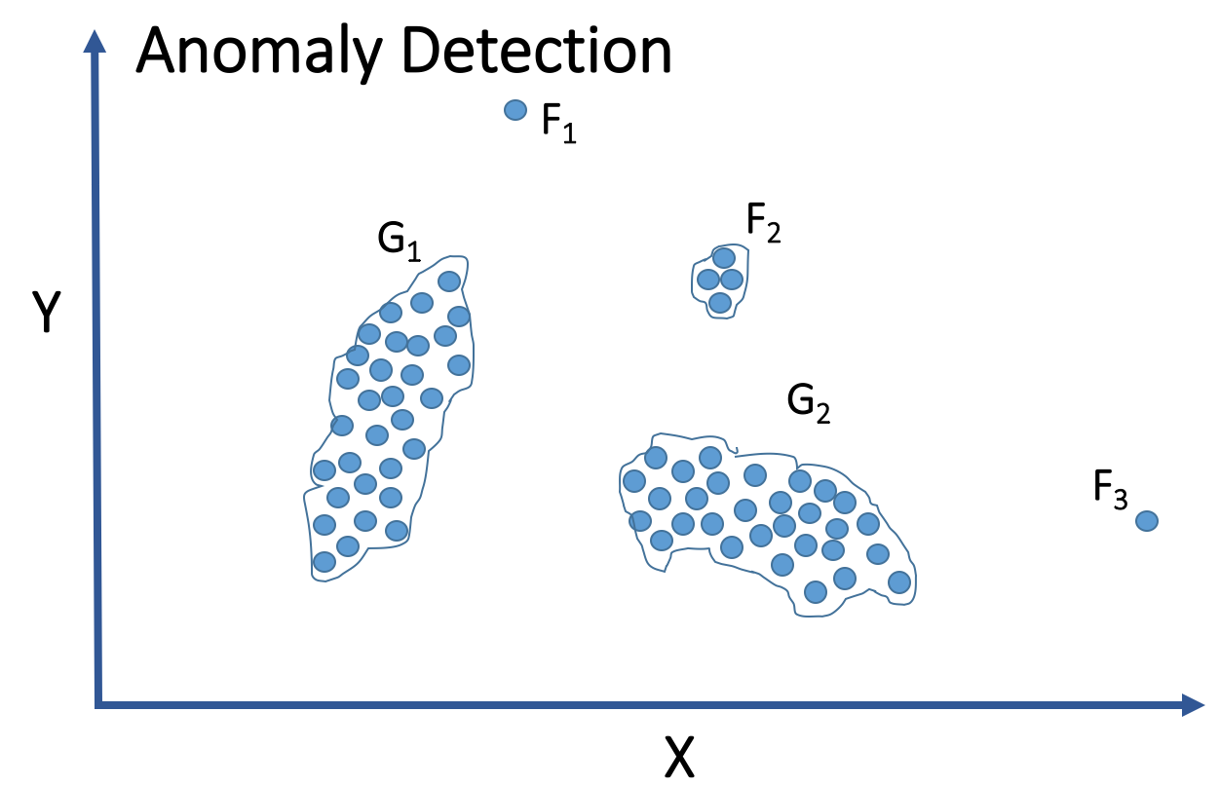
Course topics covered by Glickman (cont)
Example use of cluster analysis:

Slide 24

Course topics covered by Glickman (cont)
Bayesian statistics:

Slide 25
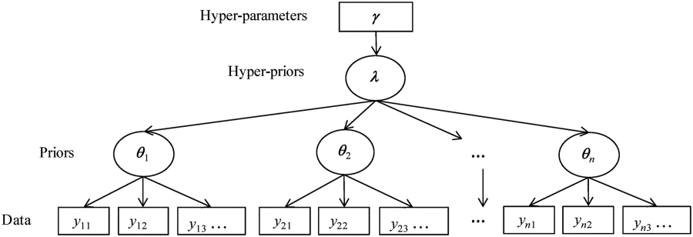
Course topics covered by Glickman (cont)
Bayesian statistics: Hierarchical modeling

Slide 26
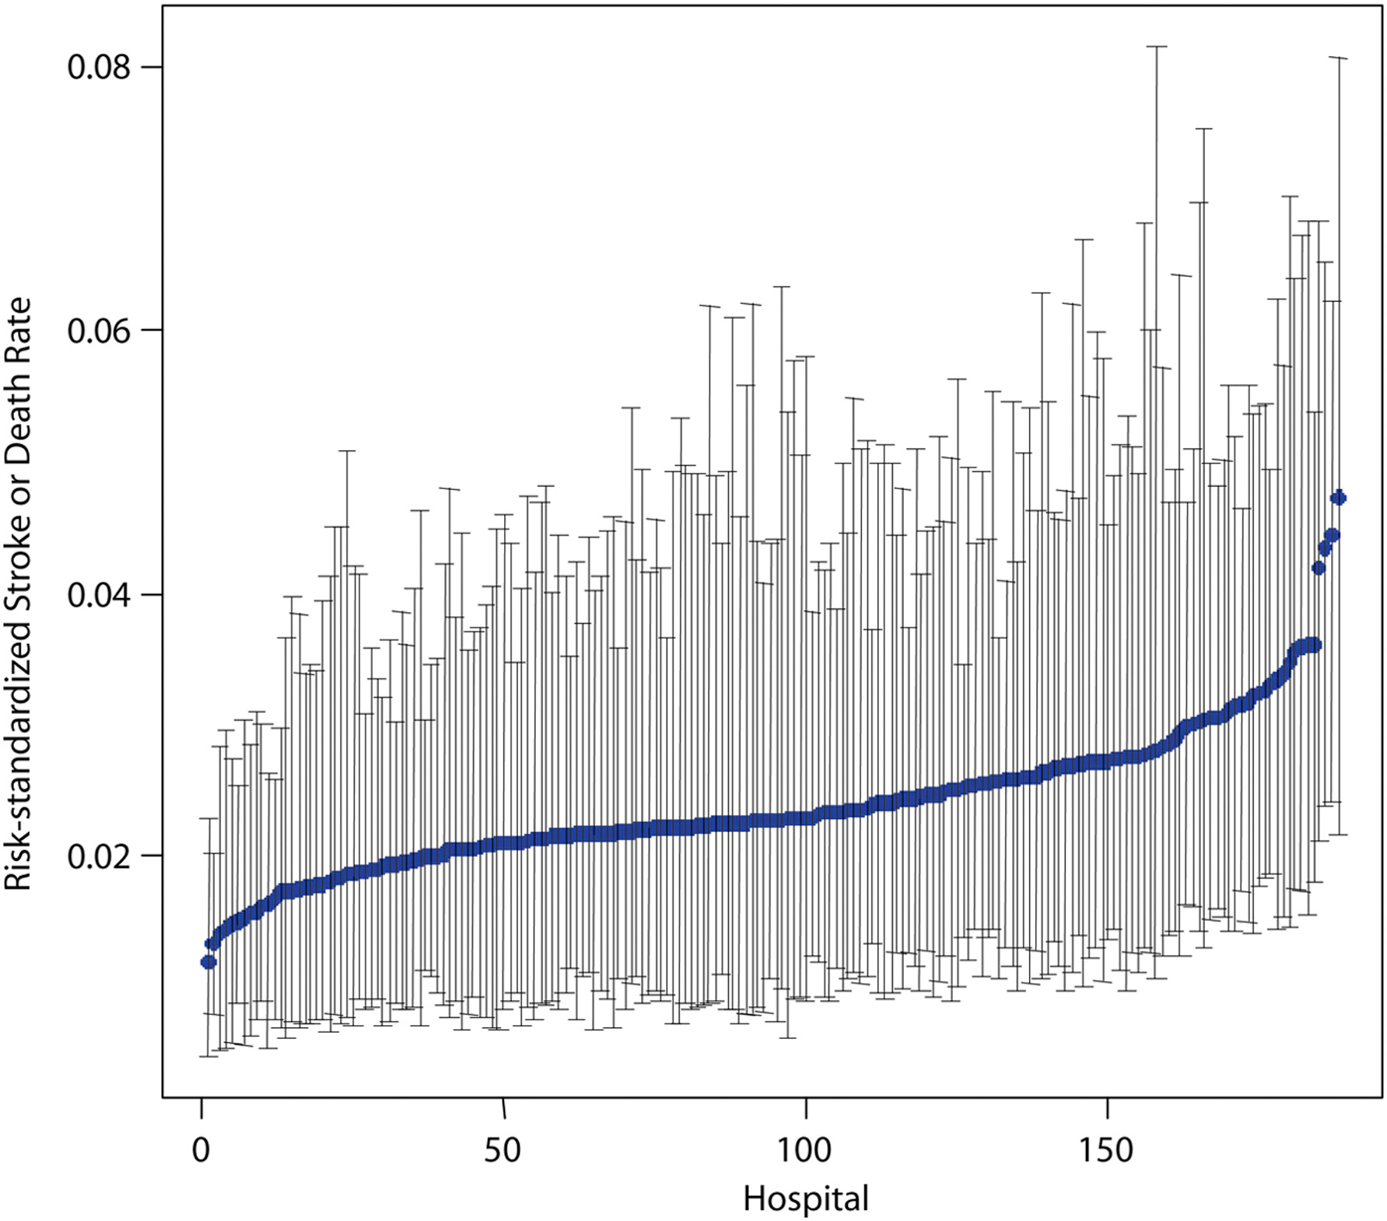
Course topics covered by Glickman (cont)
Bayesian statistics: Hierarchical modeling
Hospital Variation in Carotid Stenting Outcomes

Slide 27
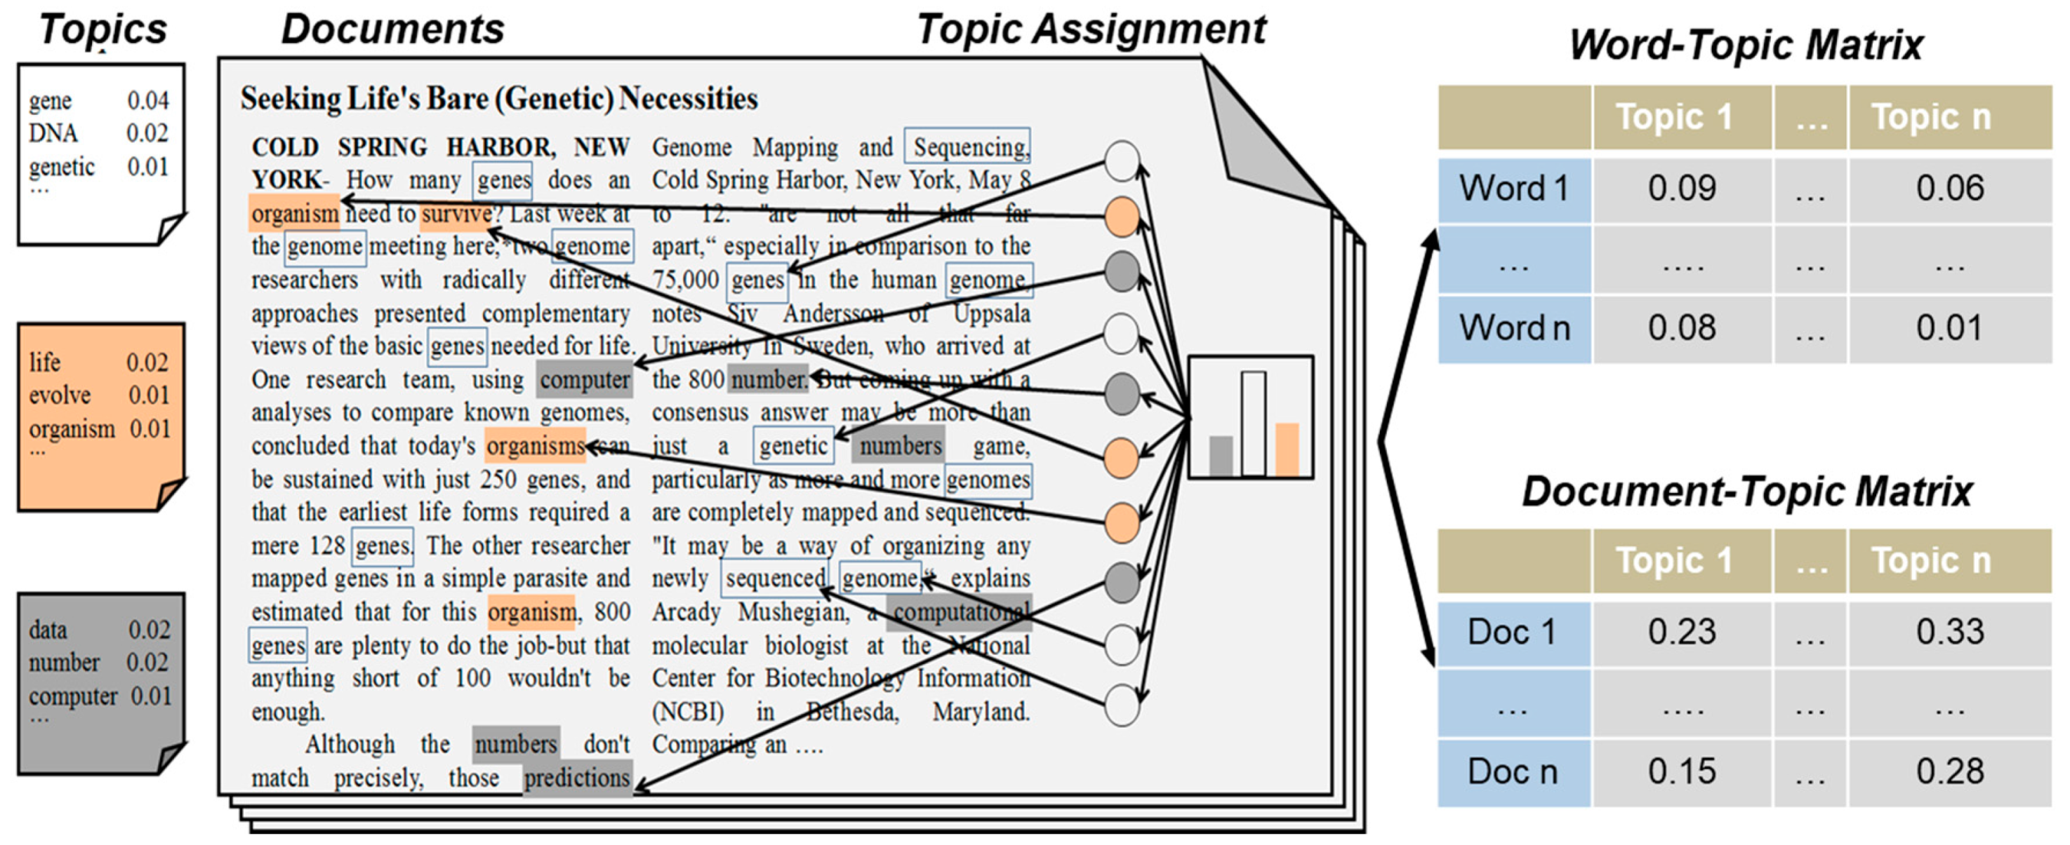
Course topics covered by Glickman (cont)
Bayesian statistics: Latent Dirichlet Allocation

Slide 28
Course topics covered by Pavlos
Deep Neural Network
Review from 109a: Neural Net Basics & Math, Deep Feed Forward, Regularization
Optimization
CNNs
RNNs
Autoencoders
Variational Autoencoders
GANs
Deep reinforcement learning

Slide 29
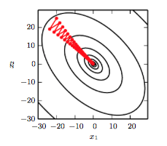
Course topics covered by Pavlos (cont)
SGD is slow when there is high accuracy
SGD
SGD with momentum

Slide 30

Notes:
LiveSlide Site
https://distill.pub/2017/momentum/

Slide 31
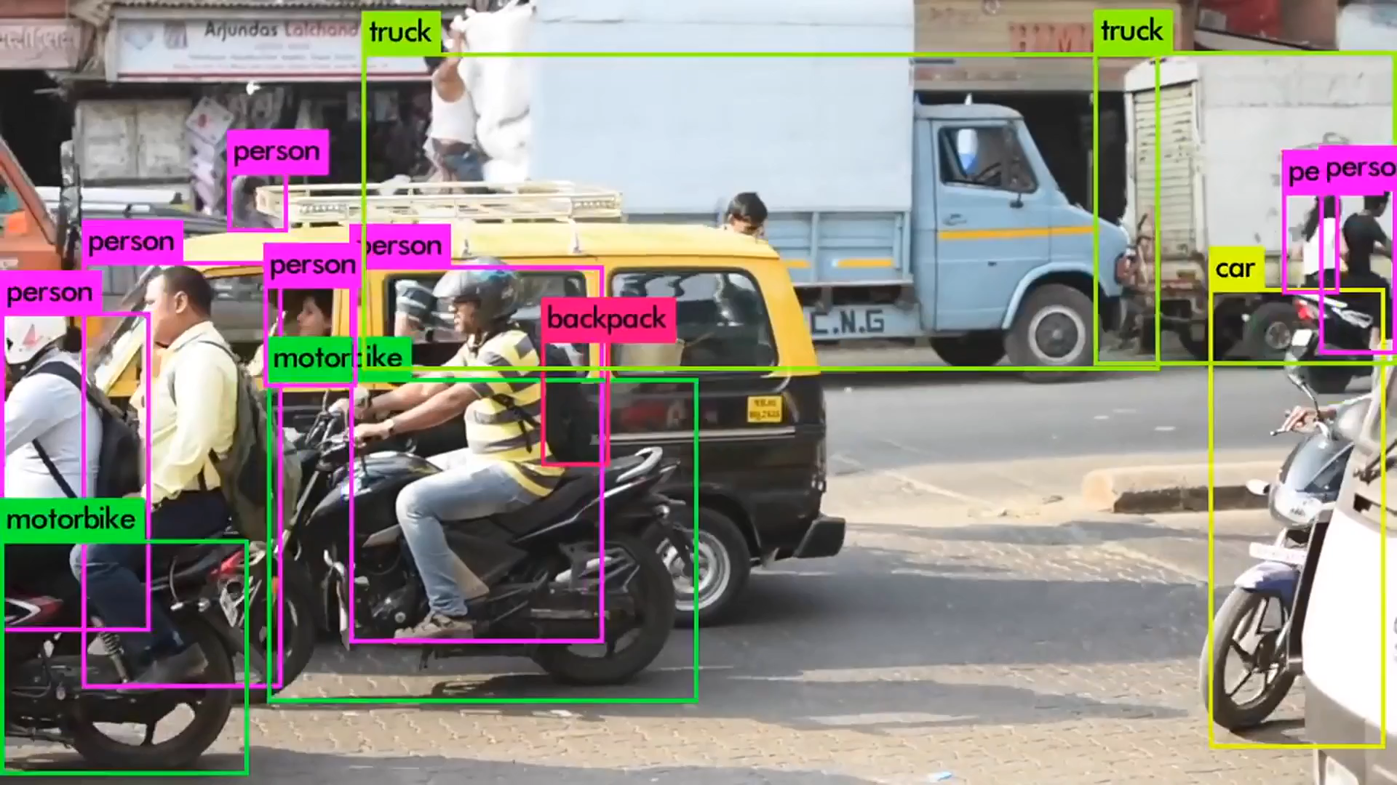
Course topics covered by Pavlos (cont)
You Only Look Once (YOLO) - 2016

Slide 32
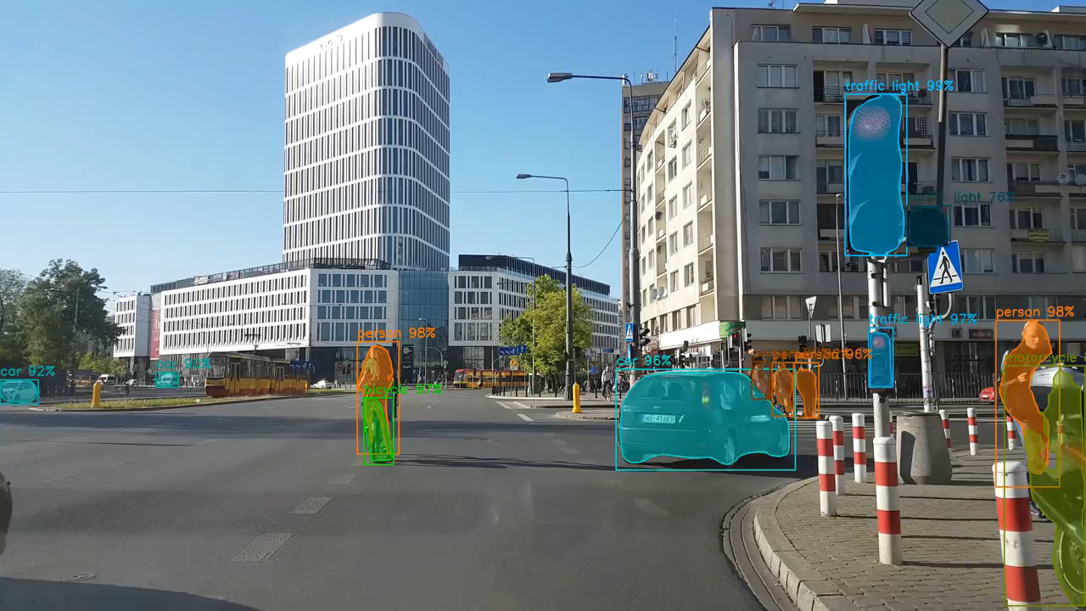
Course topics covered by Pavlos (cont)
Mask- RCNN - 2017

Slide 33
Course topics covered by Pavlos (cont)
RNN classification, e.g. sentiment analysis
Sentence:
While the music was great, the screenplay was not so engaging and hence even if I started to enjoy it, the movie failed to work for me eventually.
Actual Sentiment: Negative
Predicted Sentiment: ?

Slide 34
Course topics covered by Pavlos (cont)
RNN sequence to sequence modeling
English:
I love this course
Spanish:
Me encanta esta clase
Greek: Λατρεύω αυτή την τάξη

Slide 35
Course topics covered by Pavlos (cont)
RNN sequence to sequence modeling

Slide 36
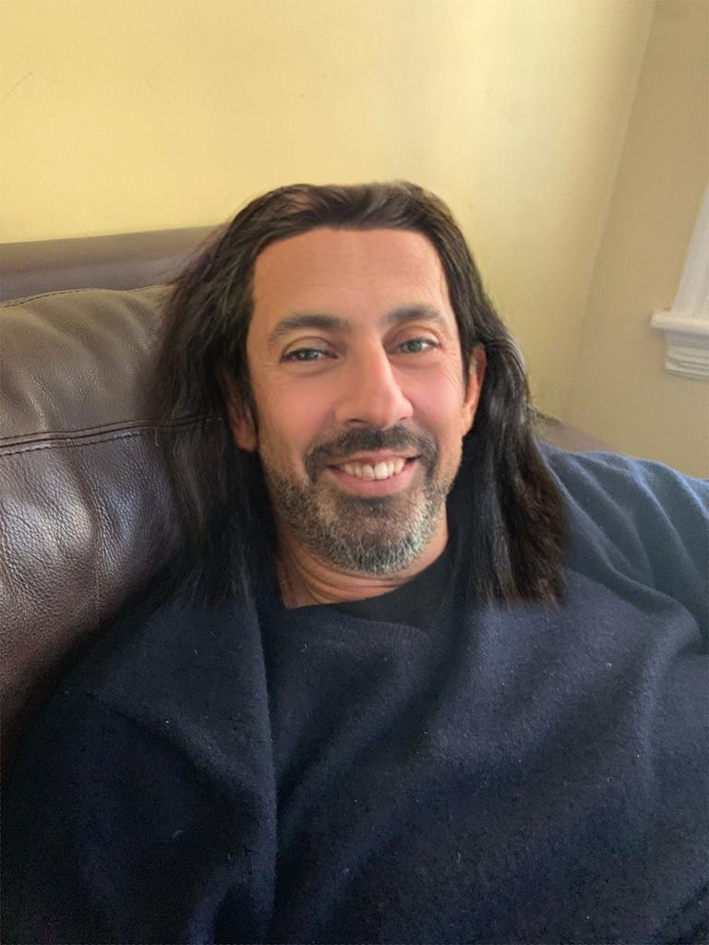
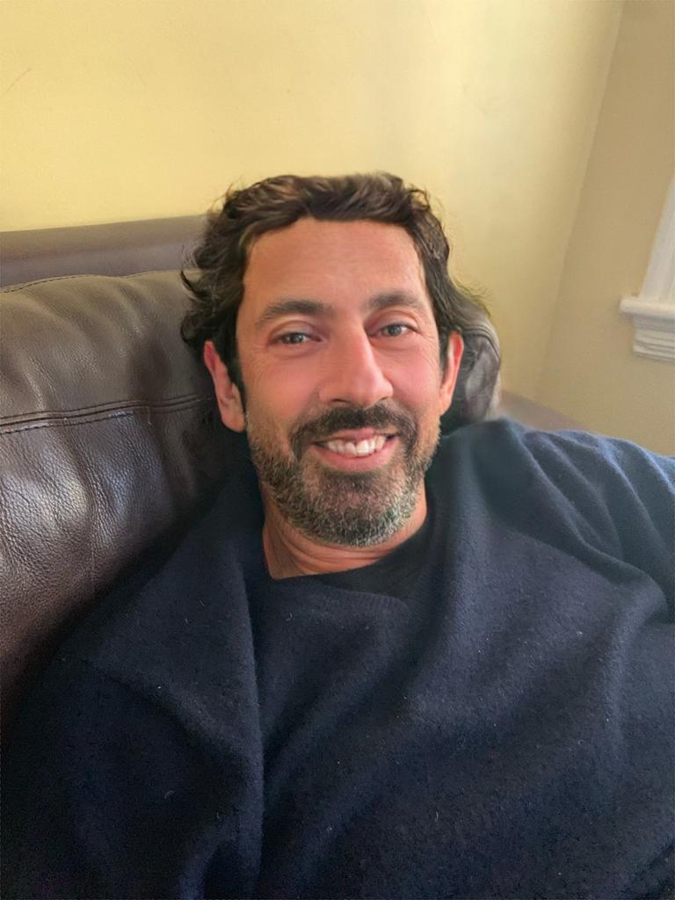
Course topics covered by Pavlos (cont)
Autoencoders and Variational Autoencoders (blending)

Slide 37
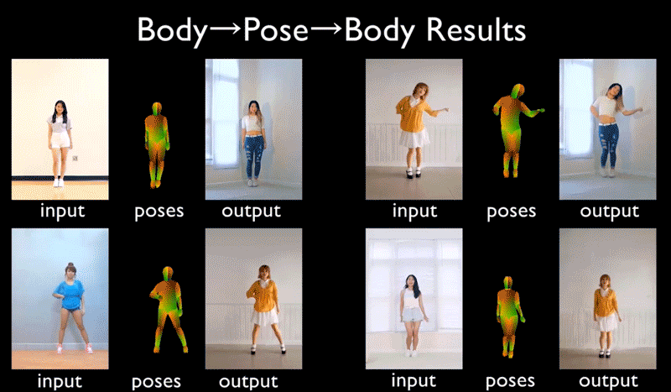
Course topics covered by Pavlos (cont)
NVIDIA Video to Video Synthesis - 2018

Slide 38
Other Topics
▶ Scalability issues: AWS
▶ Databases: SQL

Slide 39
Projects/Modules
Campus students:
During the final four (4) weeks of the course, students will be divided in break-out thematic sections where they will study topics such as medicine, law, astronomy, e-commerce, and government. Each section will include lectures by faculty, experts on the field, followed by project work also led by that faculty. You will get to present your projects in the SEAS Design Fair at the end of the semester.

Slide 40
Projects/Modules
DCE students:
The goal of the project is to have a complete end-to-end data science process encompassing both semesters of subject material while working as a 3-4 person team. We will supply a small set of project choices within the thematic categories. Teams may propose a different project with sufficient notice and will be subject to approval by the course staff.

Slide 41
Modules
Medicine: Microbiome Module
Georg Gerber, Assistant Professor of Pathology, Brigham and Women's Hospital
Through this module, you will have an opportunity to learn about the microbiome, one of the most exciting research fields in science and medicine today. You will also gain experience with analyzing complex time-series data

Slide 42
Modules
Physical Sciences. Potentially hazardous object
Matthew Holman, Harvard-Smithsonian Center for Astrophysics, Director of the Minor Planet Center
Through this module, you will have an opportunity to save the world by discovering, identifying and characterizing Potentially hazardous object

Slide 43
Modules
Law: Most likely NLP
David A. Colarusso, Clinical Fellow, and Director of the
Legal Innovation & Technology Lab
Details to come in the next few weeks.

Slide 44
Modules
Business School:
Srikanth Jagabathula, and Ashwin Jagabat, HBS
Details to come in the next few weeks.

Slide 45
Projects/Modules
Government:
David Eaves, HKS
Details to come in the next few weeks.

Slide 46
Outline
Who
What have we learned in 109a?
What is covered in 109b
Course Logistics

Slide 47
Outline
Who
What have we learned in 109a?
What is covered in 109b
Course Logistics
Lectures, Labs and Office Hours
AC209
Homeworks
Content Organization
Grades

Slide 48
Outline
Who
What have we learned in 109a?
What is covered in 109b
Course Logistics
Lectures, Labs and Office Hours
AC209
Homeworks
Content Organization
Grades

Slide 49
Lectures, Labs and Office Hours
Lectures: Mondays and Wednesdays 1:30-2:45pm @ Maxwell-Dworkin G-115.
During lecture will cover the material which you will need to complete the homework. Attending lectures is required - quizzes at the end of each lecture (drop 40% of them) .
Lecture notes and associated notebooks will be posted before lecture on Canvas and GitHub (Pavlos Lectures only)
Lectures will be video tapes (and live streamed for DCE students) and posted approximately in 24 hours on Canvas.
Note: For DCE students the quizzes are optional

Slide 50
Lectures, Labs and Office Hours (cont)
Labs: Thursdays 4:30-6:00pm @ Pierce 301
Labs are meant to help you understand the lecture materials better via examples.
Labs will also be video taped (and live streamed for DCE students) and posted approximately in 24 hours on Canvas

Slide 51
Lectures, Labs and Office Hours (cont)
Instructors Office Hours:
▶ Mark: By appointment
▶ Pavlos: Monday 3:00-4:00pm, MD G108
TF Office Hours: Check canvas in the next day or so

Slide 52
Outline
Who
What have we learned in 109a?
What is covered in 109b
Course Logistics
Lectures, Labs and Office Hours
AC209
Homeworks
Content Organization
Grades

Slide 53
AC 209 Students
Students enrolled for the AC 209B course have the following extra requirements:
Attend A-Sections
Complete extra questions in homework (HW3-HW8)
Expand the scope of the final project (modules)

Slide 54
AC 209 Students (cont)
Advance Sections Topics:
Optimization/EMD
Dropout
ConvNets: LeNet, AlexNet, VGG-15, ResNet and Inception (HW)
LSTN, GRU in NLP (HW)
Neural style transfer learning (HW)
Deep RL (HW)
Variational Inference (HW)
GANS (HW)

Slide 55
Outline
Who
What have we learned in 109a?
What is covered in 109b
Course Logistics
Lectures, Labs and Office Hours
AC209
Homeworks
Content Organization
Grades

Slide 56
Homeworks
See schedule on canvas for released dates and due dates (http://bitly.com/2FWLM0v)
Homework 0 (Due Feb 6 11:59pm) Must submit
Homework 1 on smoothing
Homework 2 on FF NN and various optimizations
Homework 3 on CNNs
Homework 4 on RNNs
Homework 5 on Clustering and Autoencoders (individual)
Homework 6 on LDA and Bayes
Homework 7 on VAE+GANS (individual)

Slide 57
Homeworks (cont)
You are encouraged but not required to submit in pairs. Instructions on how to submit in pairs are on canvas.
If you work with someone else but not submitting in pair you should indicate who you have worked with.
All assignments will be posted on Tues. at 11:59pm and will be due Wed. at 11.59pm - one or few weeks later (see schedule for details).
You only need to submit .ipynb (no need to submit pdf)

Slide 58
Homeworks (cont)
Grading: The homework provides an opportunity to learn advanced data science skills and to bolster your understanding of the material. See the homework as an opportunity to learn, and not to earn points. The homework will be graded to reflect this objective.
WE WILL BE PROVIDING LENGTHY FEEDBACK AND DETAILS HOW GRADING IS DONE (different from 109a)

Slide 59
Homeworks (cont)
Late Policy: No homework assignments will be accepted for credit after the deadline. If you have a verifiable medical condition or other special circumstances that interfere with your coursework please let us know as soon as possible by sending an email to the Helpline.

Slide 60
Homeworks (cont)
Late Policy: No homework assignments will be accepted for credit after the deadline. If you have a verifiable medical condition or other special circumstances that interfere with your coursework please let us know as soon as possible by sending an email to the Helpline.

Slide 61
Homeworks (cont)
Regrades: Our graders and instructors make every effort in grading accurately and in giving you a lot of feedback.
If you discover that your answer to a homework problem was correct but it was marked as incorrect, send an email to the Helpline with a description of the error. Please do not submit regrade requests based on what you perceive is overly harsh grading.
The points we take off are based on a grading rubric that is being applied uniformly to all assignments.
If you decide to send a regrade request, send an email to the Helpline with subject line "Regrade HW1: Grader=johnsmith" within 48 hours of the grade release.

Slide 62
Content Organization
Github: https://github.com/Harvard-IACS/2019-CS109B
▶ Lab files and solutions
▶ Advanced Section materials
▶ Lectures (Pavlos’ lectures only)
Assignments and Mark’s lectures will only be posted on Canvas.

Slide 63
Grades
Paired-option Homeworks: 45% (5 homework for which you have the option to work in pairs)
Individual Homeworks: 25% (2 homework which you must complete individually, HW5 and HW7)
Quizzes: 10% (you may drop 40% of the quizzes)
Project: 20%

Slide 64
Academic Integrity
Ethical behavior is an important trait of a Data Scientist, from ethically handling data to attribution of code and work of others. Thus, in CS109 we give a strong emphasis to Academic Honesty.
As a student your best guidelines are to be reasonable and fair. We encourage teamwork for problem sets, but you should not split the homework and you should work on all the problems together.
Please be responsible and when in doubt ask either Pavlos, Mark, Eleni or Sol.

Slide 65
Auditing
Auditors are welcomed!
If you would like to audit the class, please send an email to the Helpline indicating who you are and why you want to audit the class. You need a HUID to be included to Canvas.
The only stipulation is that you don't plan to ask the teaching staff for help, attend office hours, etc., as these resources are intended for registered students.

Slide 66

Recommended Textbooks
ISLR: An Introduction to Statistical Learning, by James, Witten, Hastie, Tibshirani (Springer: New York, 2013)
DL: Deep Learning (http://www.deeplearningbook.org/) by
Goodfellow, Bengio and Courville.

Slide 67
Accommodations for students with disabilities
Students needing academic adjustments or accommodations because of a documented disability must present their Faculty Letter from the Accessible Education Office (AEO) and speak with the professor by the end of the second week of the term.
Failure to do so may result in the Course Head's inability to respond in a timely manner. All discussions will remain confidential.

Slide 68
Diversity and Inclusion
If you have a name and/or set of pronouns that differ from those that appear in your official Harvard records, please let us know!
If you feel like your performance in the class is being impacted by your experiences outside of class, please don’t hesitate to come and talk with us. If you prefer to speak with someone outside of the course, you may find helpful resources at the Harvard Office of Diversity and Inclusion.
We (like many people) are still in the process of learning about diverse perspectives and identities. If something was said in class (by anyone) that made you feel uncomfortable, please talk to us about it.
See our diversity and inclusion statement on canvas

Slide 69

Looking forward to a fun and productive semester!

